Slide 1
NAO
Getting started
21-08-2019
Richard van Santen

Slide 2
What’s in the box?
01

Slide 3
Installation
NAO (password: altran2018)
WIFI Access point + Adapter (router admin password: altran2018)
Charger for NAO
Additional battery for NAO

Slide 4

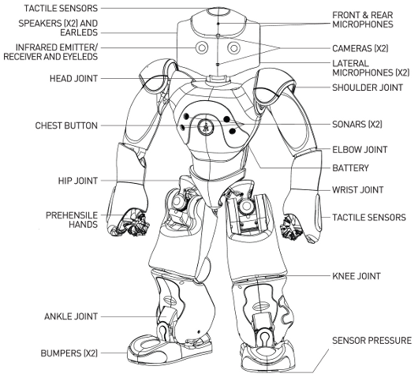
NAO Overview
Microphone 4 directional
Speakers 4 directional
Camera 1280*960@30fps 2x
Sonar 2x
IR Leds 2x
Internet: Wifi / Ethernet
USB for connecting e.g. Arduino board for additional sensors
19 languages for recognition and text to speech
ATOM Z530 1.6GHz CPU, 1 GB
60min of active use (5h charging)
Easy programming with Choregraphe
Development on Windows, Mac and Linux
Develop in C++, Python, .NET, Java, MatLab and Urbi

Slide 5
Start Learning with NAO
01
What is in the box?
02
Installation
03
Start using the tooling
04
Download links

Slide 6
Installation
02

Slide 7
Installation
Install Choregraphe Suite 2.1.4
Available for Windows, Linux and Mac
When asked use this key: 654e-4564-153c-6518-2f44-7562-206e-4c60-5f47-5f45
To connect to NAO make sure you are connected to the same wifi as NAO. The wifi accesspoint is also in the case with NAO. The password of the WIFI is on the bottom of the AP.
After powering up NAO (by pressing and hold his chest button) you can press the power button on his chest once, this will let NAO tell his / her IP address.
This IP can be used to connect to NAO from the Chroregraphe software.
NOTE: Normally the software will also start a virtual robot to test with (except audio)
Make sure you have docker installed

Slide 8
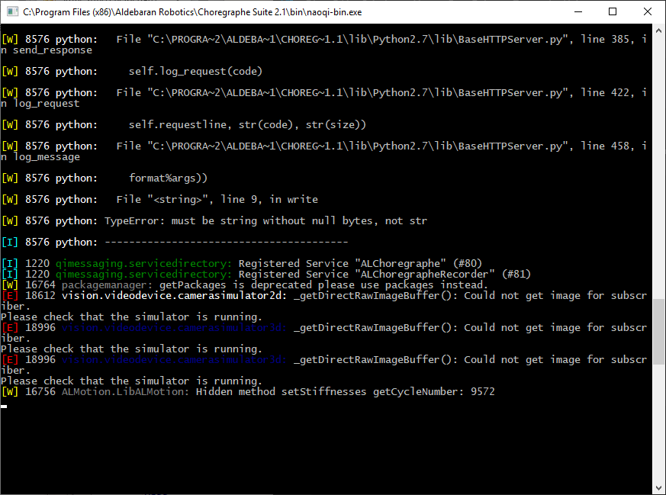
Naoqi-bin
Standalone simulator
Can connect the Choregraphe to this simulator
Can connect Python SDK to this simulator
Use docker container provided in repo or: docker run -it –rm rvsanten/naopy

Slide 9
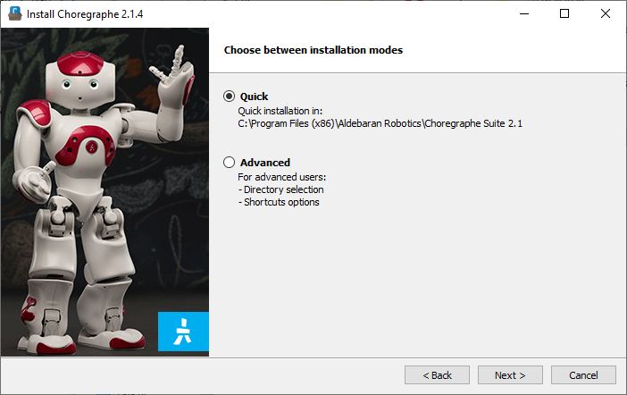
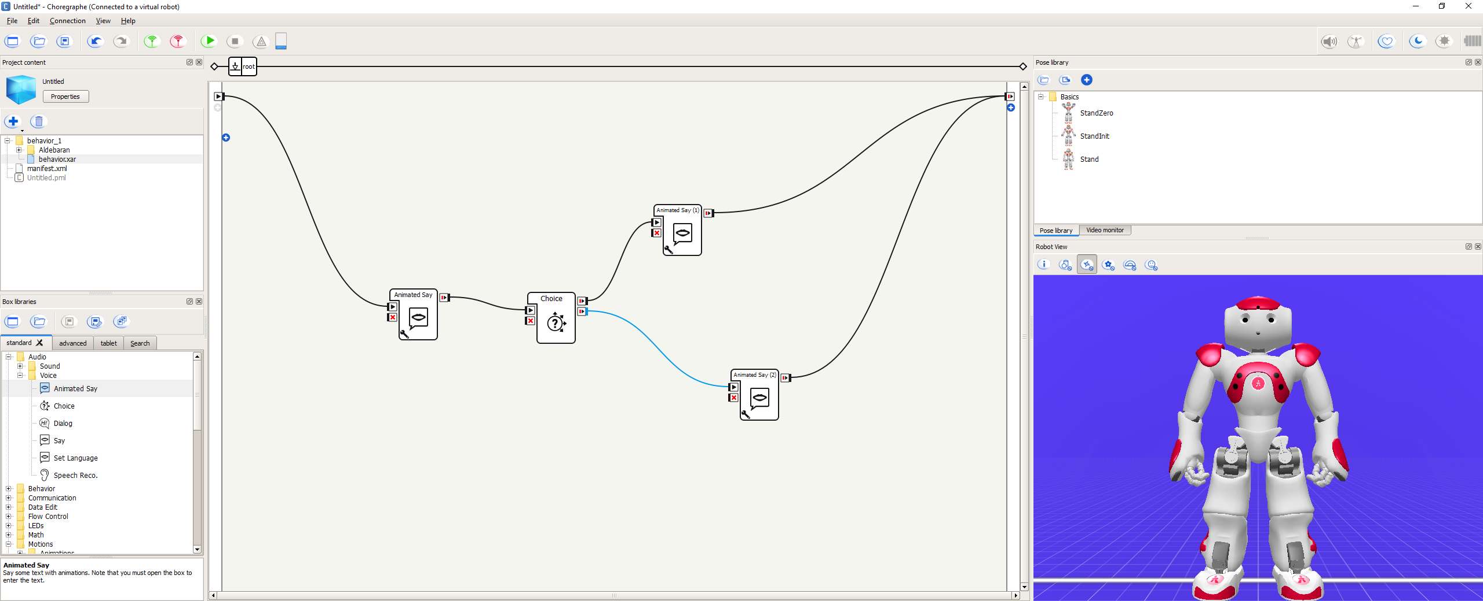
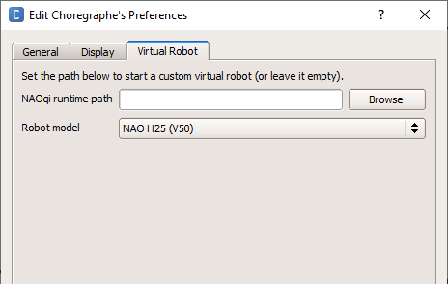
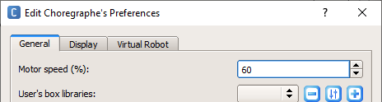
Appendix: Choregraphe 2.1.4
After startup it will automatically connect to the virtual robot
Edit → Preferences to e.g. change virtual robot type and reduce motor speed

Slide 10
How-to start using the tooling
03

Slide 11
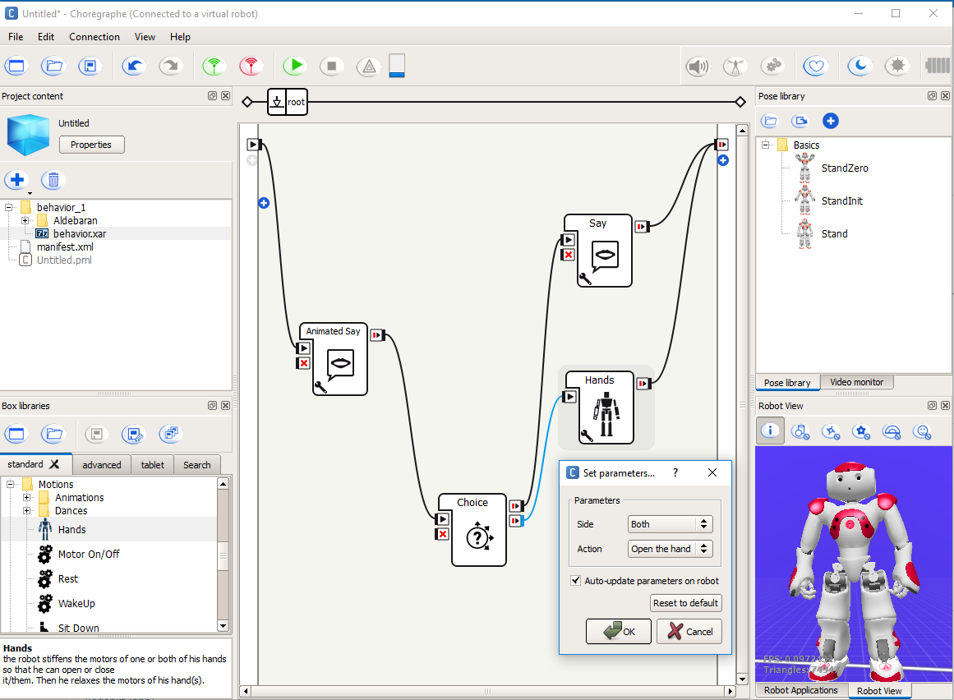
Choregraphe
Upload and start this behavior
Connect input and outputs
Pose libary, pre program robot poses
Building block library
Drag / Drop
Set parameters for building block, can also be done in code

Slide 12
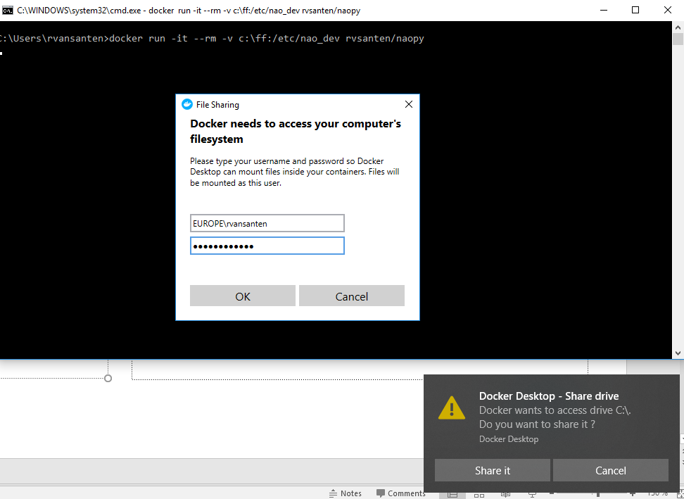
Using python in docker container
docker run -it --rm -v c:\ff:/nao_dev rvsanten/naopy
Use /nao_dev as working directory in the container
See the test script nao_move.py. This can be used to test the connection to Nao or virtual Nao. Edit the line: motionProxy = ALProxy("ALMotion", "192.168.1.13", 9559). Change ip and port accordingly.

Slide 13
Links
04

Slide 14
Appendix: Download Links
URL | Info
https://community.ald.softbankrobotics.com/en/resources/software/language/en-gb/robot/nao-2 | Nao downloads (account required)
https://community.ald.softbankrobotics.com/en/resources/software/former-nao-versions-choregraphe-suite | Choregraph download if needed
https://github.com/rvsanten/thingy | Source code for docker container and location of this ppt
https://docs.docker.com/docker-for-windows/install/ | Docker installer

Slide 15
Additional Reading
https://en.wikipedia.org/wiki/Nao_(robot)
https://www.ald.softbankrobotics.com/en/robots/nao/find-out-more-about-nao
https://developer.softbankrobotics.com/
https://developer.softbankrobotics.com/us-en/downloads/nao-v5-v4
https://stackoverflow.com/questions/tagged/choregraphe+pepper+nao-robot
https://developer.softbankrobotics.com/us-en/documents/developing-our-robots
http://doc.aldebaran.com/2-5/index.html
http://doc.aldebaran.com/2-1/family/robots/connectivity_nao.html
http://doc.aldebaran.com/1-14/family/robots/languages.html
http://www.acapela-group.com/
https://robotdiscounter.com/catalogsearch/result/?q=nao
https://developer.softbankrobotics.com/us-en/downloads/nao-v5-v4
https://youtu.be/fUyU3lKzoio
https://www.youtube.com/watch?v=wNkAr9bRJ1w
https://www.youtube.com/watch?v=2laujomh0JY
Arduino
http://www.youtube.com/watch?v=hf_6SNGZyXQ
https://www.youtube.com/watch?v=57Z4vLBgynI
https://www.youtube.com/watch?v=qghOyez6PRA

